Slide 1
New York City Motor Vehicle Collisions Analysis
Created by
Leonardo Carrillo Maldonado
Franklin Sierra
Adrian Villanueva

Slide 2
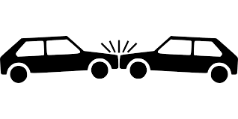
Why did We choose the Topic?
Car accidents, for the most part, ARE avoidable. However, without fully understanding the cause of car accidents, it can be difficult for individuals to know what they can do to prevent them. Some causes are more obvious than others, such as drinking and driving, while others are not so well known.

Slide 3

Agenda
Data Source and GitHub
Loading the Data Set
Training the ML Model
Regression Analysis
Borough Analysis
Key Contributing Factors
Density Map
Conclusion

Slide 4
Data Source and Github
Data Source – NYC Open Data
https://data.cityofnewyork.us/Public-Safety/Motor-Vehicle-Collisions-Crashes/h9gi-nx95
Github – Link to tutorial documents and resources https://github.com/LeoCarri/Group5_ES_Presentation

Slide 5
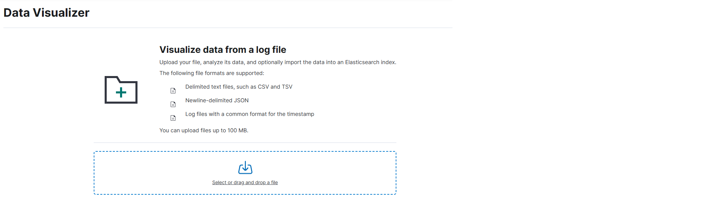
Loading the Data Set
In order to use the newly sampled data, we must load it into Elastic Cloud. To do this, we will load it via the Machine Learning > Data Visualizer > File

Slide 6
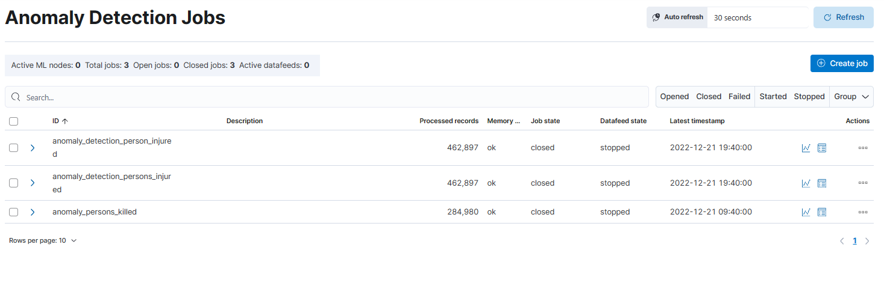
Machine Learning – Anomaly Detection Number of Persons Injured
For this lab, we will be training the ML Model to find the anomalies of persons injured in our data set.
We will go to Home > Machine Learning > Anomaly Detection > Jobs > Create Jobs

Slide 7
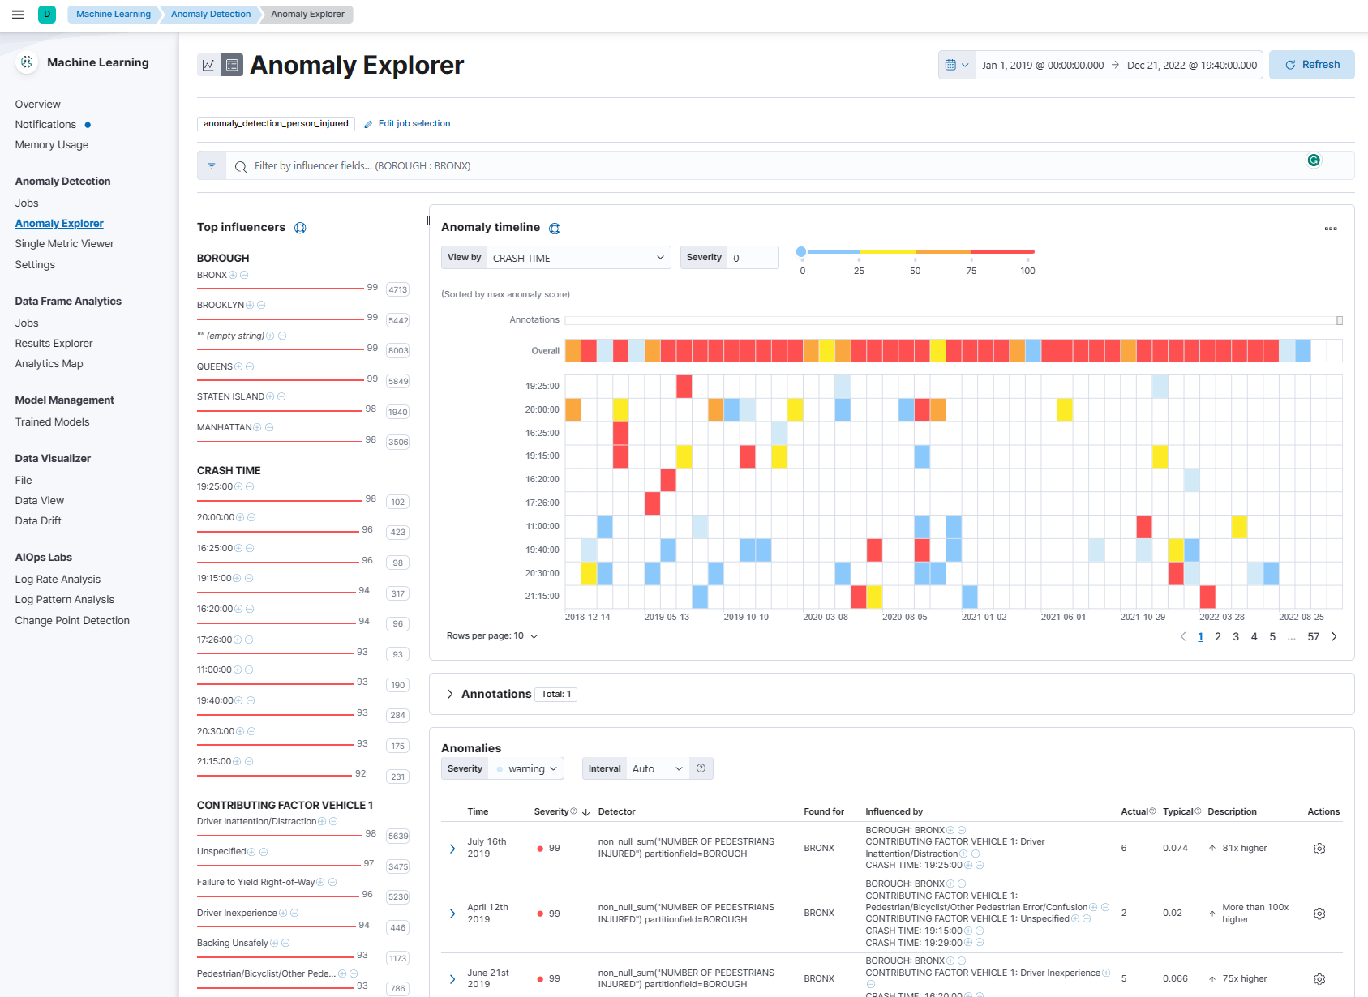
Anomaly Detection Analysis Number of Person Injured
After training the model for Anomaly Detection, we can analyze the results.
We are viewing the Anomaly Timeline by Crash Time
We can see that there are scattered anomalies with very high Severity Scores
Borough, Crash Time, and Contributing Factor Vehicle 1 include Influencers with High Severity Scores
Borough is the most influential of the three

Slide 8
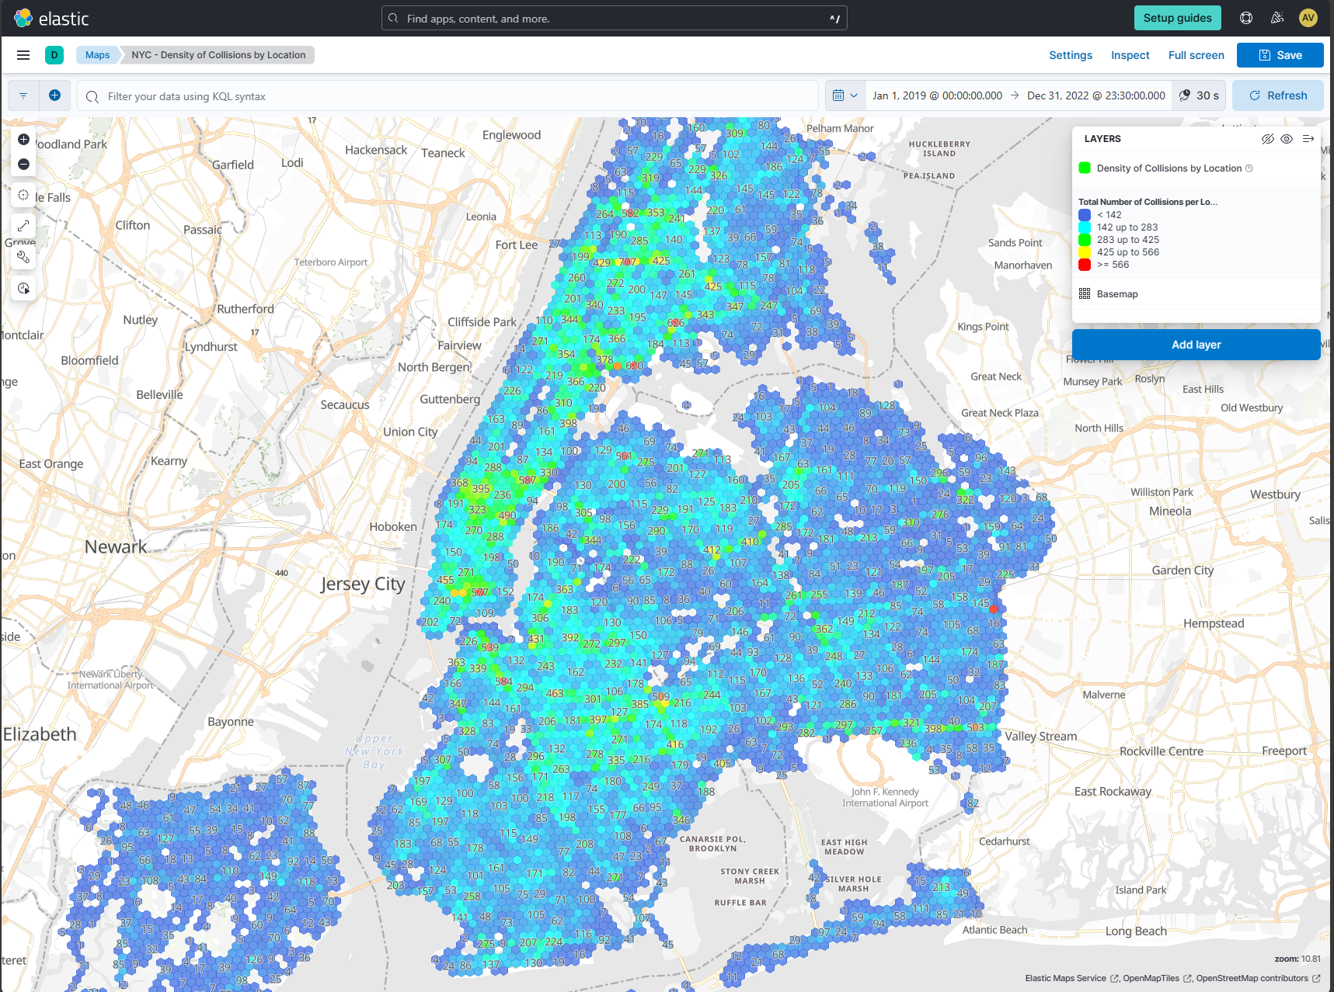
Density Map by Specific Location

Slide 9
Density Map by Specific Location
Our density map visually follows a heat map. The higher the density of collisions, the brighter “hotter” the spot
New York at first glance does not have a ton of collisions over the 3 years, but there more populated and tourist heavy locations show the greatest density in collisions
Manhattan
Bronx

Slide 10
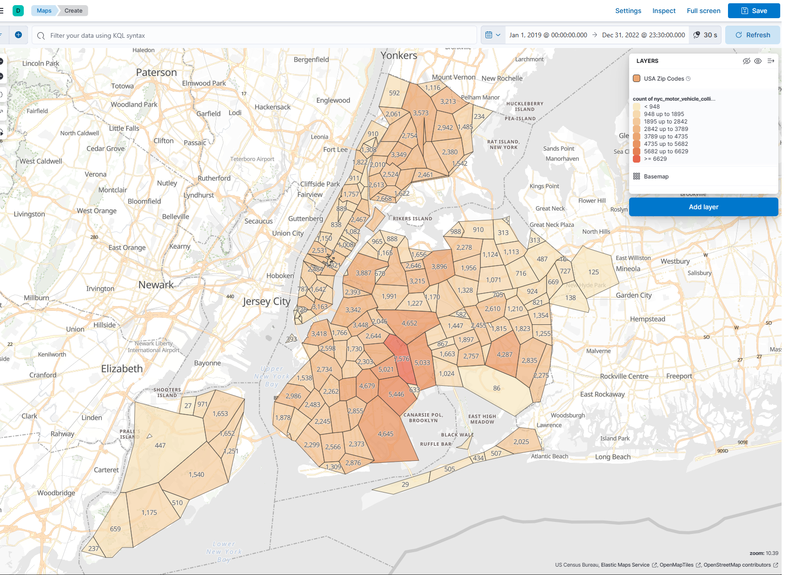
Density Map By Zip
Taking a look at density in a different grouping, by Zip
This enables us to expand our understanding of how New York itself is divided
We can assume that the ZIP codes with the highest number of collisions are densely populated or highly traveled through

Slide 11
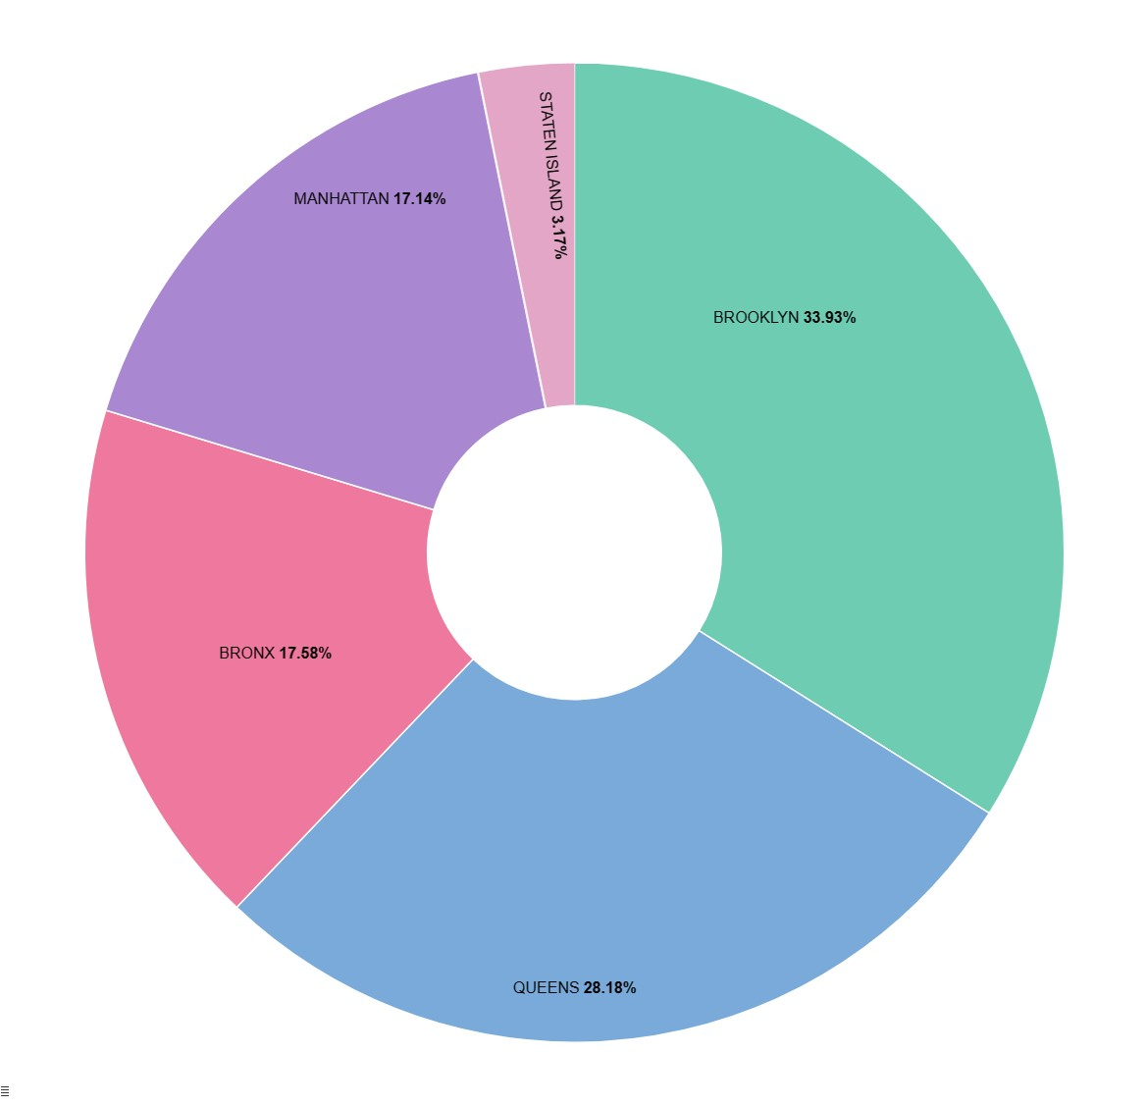
Borough Analysis
When thinking of New York, we usually separate the city into 5 Major Boroughs
Brooklyn
Bronx
Manhattan
Queens
Staten Island
If we ever wanted to move to New York and needed to decide on which Borough to live in, we can use this chart to help inform this decision

Slide 12
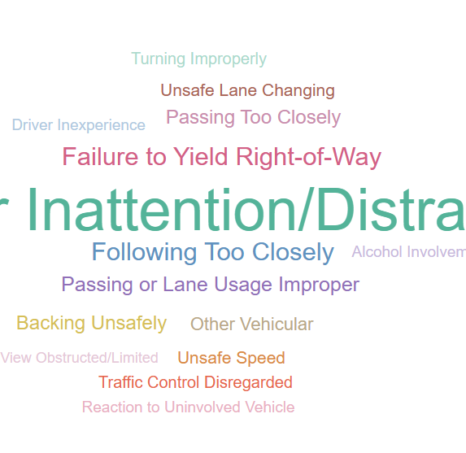
Key Contributing Factors to Collisions
There are many factors that come in to play when collisions occur
Within Elastic Search, we are able to determine the top 15 Key Contributing factors to Collisions
This information is highly valuable to Law Makers when trying to reduce the amount of collisions in the city

Slide 13
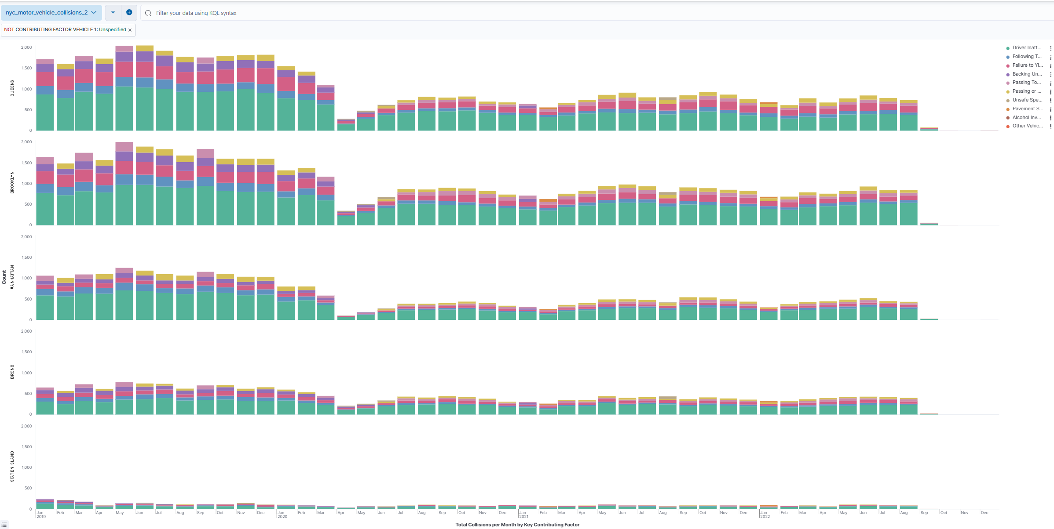
Combining Borough and Key Contributing Factors

Slide 14

Combining Borough and Key Contributing Factors
In a Historgram, we able to view how the Key Contributing Factors to Collisions correlate to the total sum of collisions each month, by borough
Highly Dense boroughs do tend to have more collisions, but here we are looking at the Key Contributing Factors account for those collisions
Irresponsible drivers is something as an individual we cannot control, so it would be best to avoid the boroughs that tend to have a lot of collisions where the drivers are being irresponsible or inattentive

Slide 15
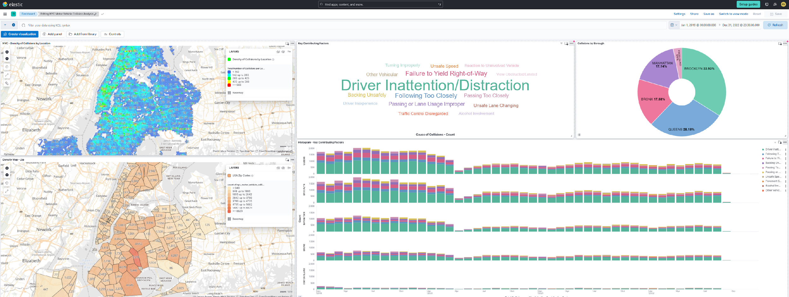
New York City Motor Vehicle Collisions Dashboard
Our dashboard brings all our visualizations into a single view so we can better understand how they are related.

Slide 16
Resources
“Starting with the Elasticsearch Platform and Its Solutions.” Elastic, www.elastic.co/guide/index.html?utm_campaign=Google-B-Amer-US&utm_content=Stack-Documentation-EXT&utm_source=google&utm_medium=cpc&device=c&utm_term=elasticsearch+documentation&gad_source=1&gclid=Cj0KCQiA67CrBhC1ARIsACKAa8RTNr9R01AgT4NK9mA9zsRkGZ9KQWT7rRebDXSXZHQBZSzdibzsuwUaAk6_EALw_wcB. Accessed 3 Dec. 2023.
(NYPD), Police Department. “Motor Vehicle Collisions - Crashes: NYC Open Data.” Motor Vehicle Collisions - Crashes | NYC Open Data, 1 Dec. 2023, data.cityofnewyork.us/Public-Safety/Motor-Vehicle-Collisions-Crashes/h9gi-nx95.

Slide 17
Fin

